Slide 1

6th Grade Math
Unit 5, Lesson 5 Distance on the Coordinate Plane Volume 1, pg. 226

Slide 2


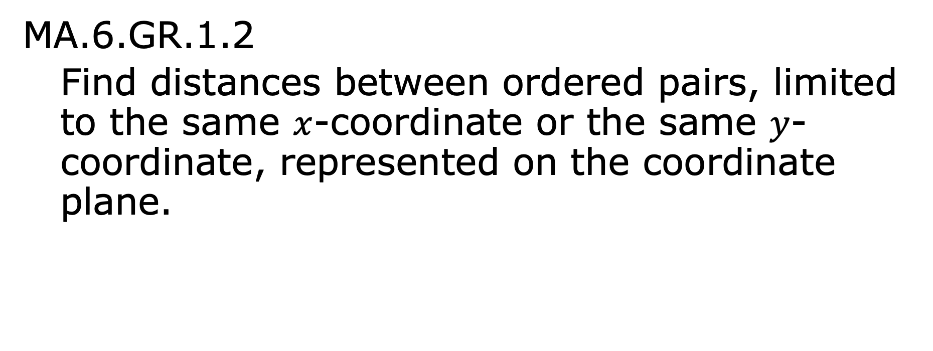
Benchmark
MA.6.GR.1.2
Find distances between ordered pairs, limited to the same $x$-coordinate or the same $y$-coordinate, represented on the coordinate plane.
volume 1, pg. 226

Slide 3
Integrated Mathematical Thinking and Reasoning Standards
MA.K12.MTR.1.1 Actively participate in effortful learning both individually and collectively.
MA.K12.MTR.4.1 Engage in discussions that reflect on the mathematical thinking of self and others.
MA.K12.MTR.5.1 Use patterns and structure to help understand and connect mathematical concepts.
volume 1, pg. 226

Slide 4

Learning Target
I can find the distance between two ordered pairs.
volume 1, pg. 226

Slide 5

Warm-Up
volume 1, pg. 227

Slide 6
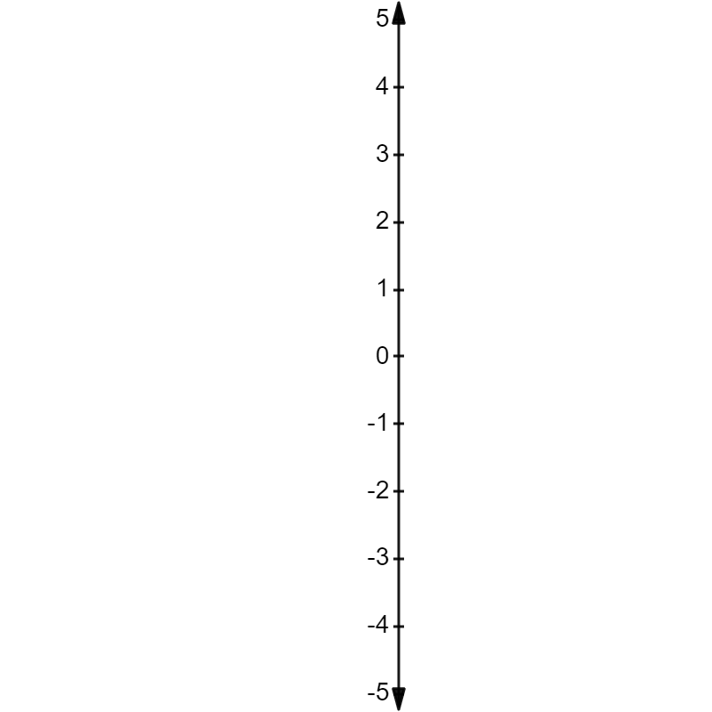
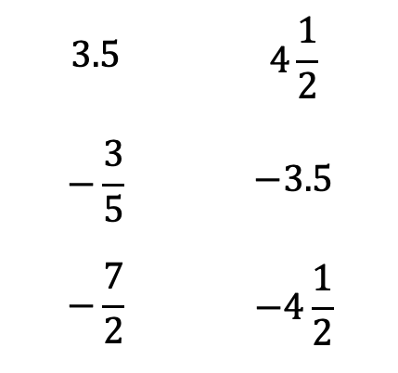
5.5.1 Warm-Up: A Point on the Number Line
Circle all numbers that could be the location of point $F$ on the number line.
$$3.5$$ | $$4\frac{1}{2}$$
$$−\frac{3}{5}$$ | $$−3.5$$
$$−\frac{7}{2}$$ | $$−4\frac{1}{2}$$
volume 1, pg. 227

Slide 7

Collaboration
volume 1, pg. 227

Slide 8

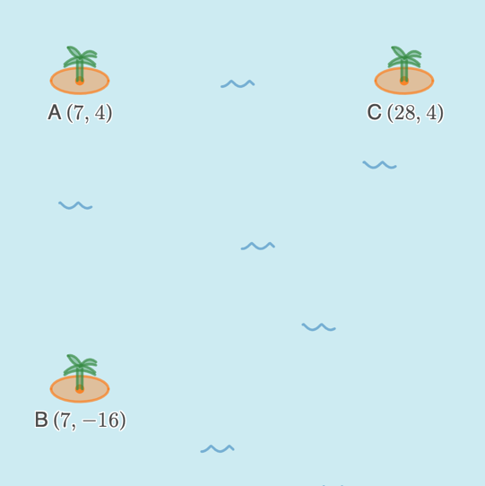
5.5.2 Collaboration: Who Is Correct?
The locations of three islands in the ocean are given using ordered pairs.
volume 1, pg. 227

Slide 9
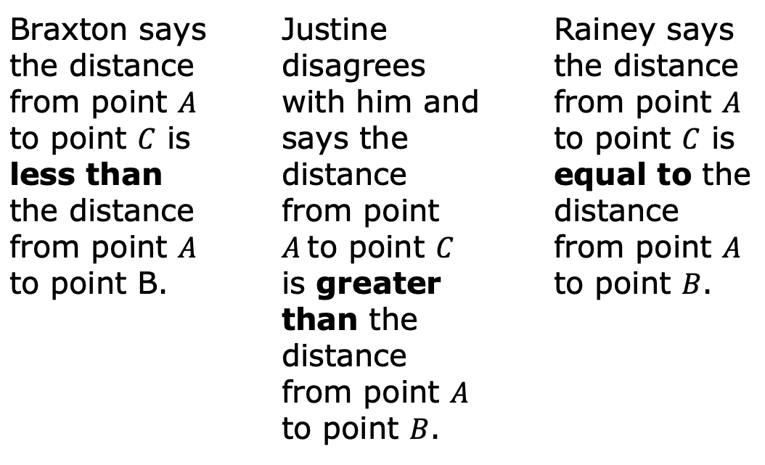
Three students described the distance between each island.
Discuss with your partner who you think is correct. Write a summary of your discussion.
Discuss with your partner who you think is correct. Write a summary of your discussion.
Braxton says the distance from point $A$ to point $C$ is less than the distance from point $A$ to point B. |  | Justine disagrees with him and says the distance from point $A$to point $C$ is greater than the distance from point $A$ to point $B$. |  | Rainey says the distance from point $A$ to point $C$ is equal to the distance from point $A$ to point $B$.
volume 1, pg. 228

Slide 10

Guided Instruction
volume 1, pg. 228

Slide 11
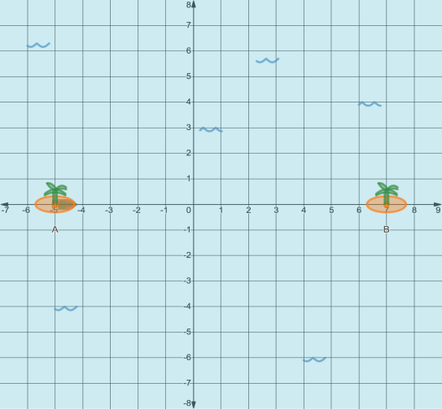

5.5.3 Guided Instruction: Distance on the Coordinate Plane
The coordinates of two small islands are labeled points $A$ and $B$ on the graph.
Counting the grid lines, how far apart are the islands?
volume 1, pg. 228

Slide 12
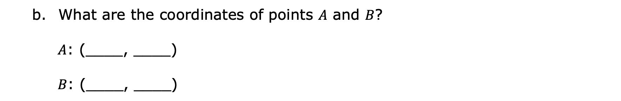
What are the coordinates of points $A$ and $B$?
$A$: (____, ____)
$B$: (____, ____)
volume 1, pg. 228

Slide 13


Explain why the $y$-coordinates of the two points are the same.
Describe the location of the two points relative to the $y$-axis.
The distance a number is from zero (0) on a number line is called the absolute value.
volume 1, pg. 229

Slide 14
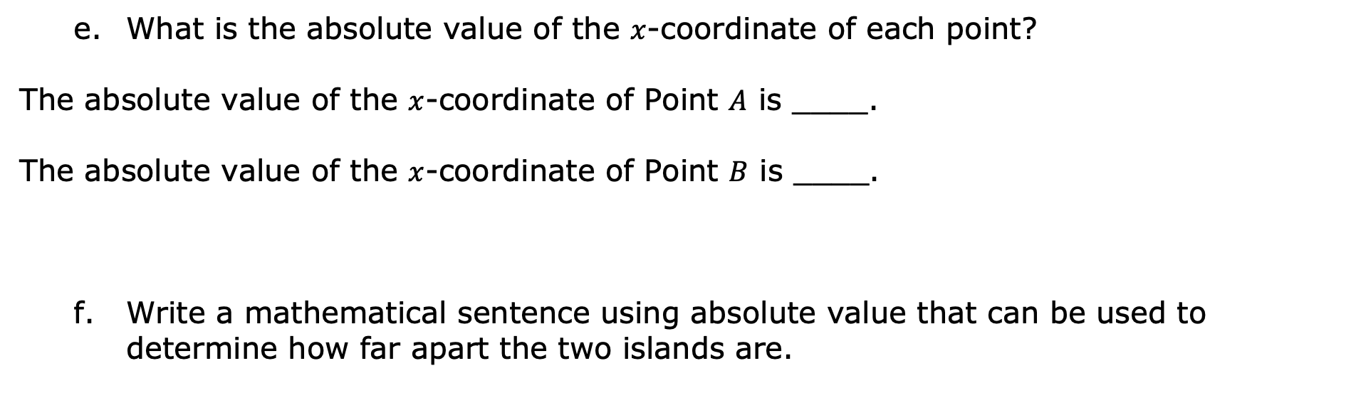
What is the absolute value of the $x$-coordinate of each point?
The absolute value of the $x$-coordinate of Point $A$ is ____.
The absolute value of the $x$-coordinate of Point $B$ is ____.
Write a mathematical sentence using absolute value that can be used to determine how far apart the two islands are.
volume 1, pg. 229

Slide 15
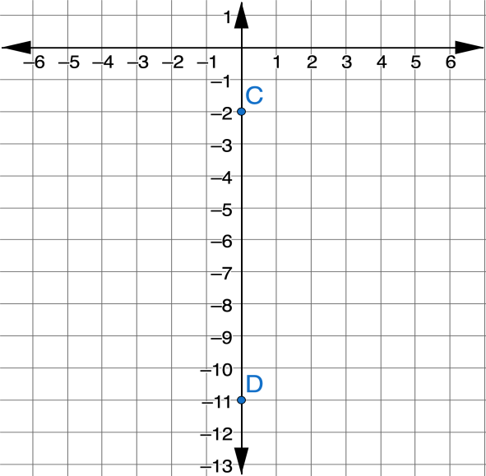

Below is another coordinate plane with two different islands located at points $C$ and $D$.
How is the location of these two islands different from the first two you worked with?
volume 1, pg. 229

Slide 16

Counting the grid lines, how far apart are the islands?
What are the coordinates of points $C$ and $D$?
$C$: (____,____)
$D$: (____,____)
volume 1, pg. 229

Slide 17
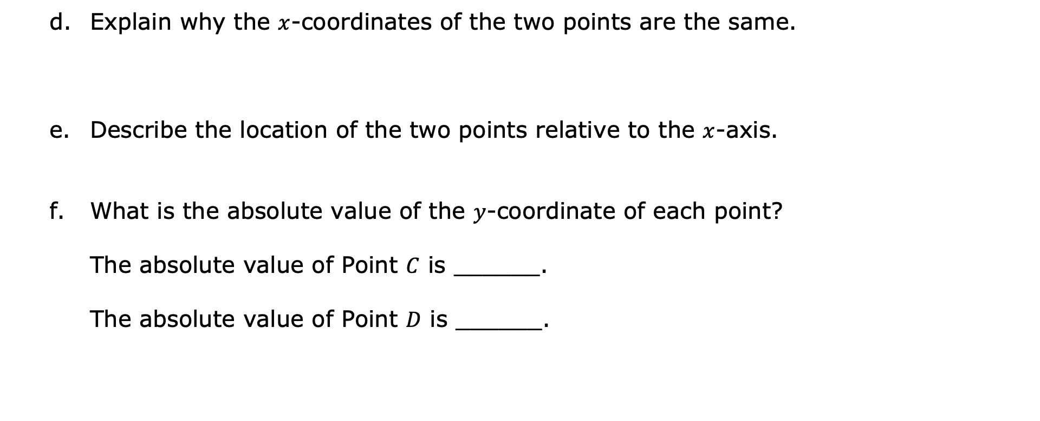
Explain why the $x$-coordinates of the two points are the same.
Describe the location of the two points relative to the $x$-axis.
What is the absolute value of the $y$-coordinate of each point?
The absolute value of Point $C$ is ______.
The absolute value of Point $D$ is ______.
volume 1, pg. 230

Slide 18
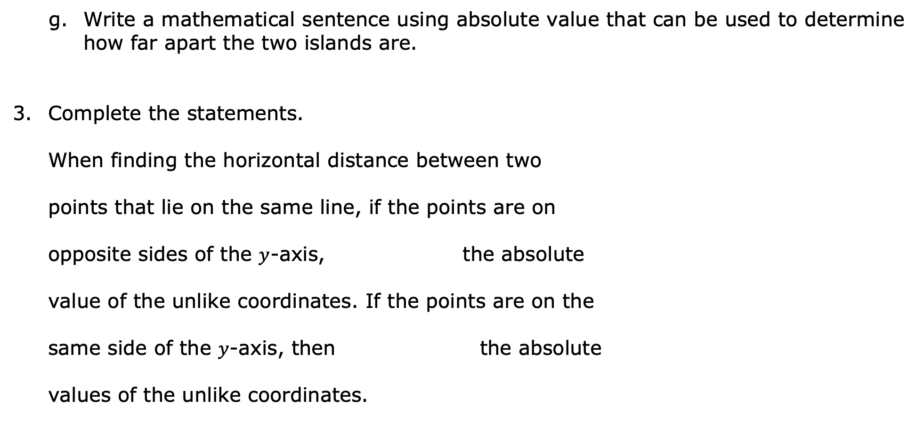
Write a mathematical sentence using absolute value that can be used to determine how far apart the two islands are.
Complete the statements.
When finding the horizontal distance between two
points that lie on the same line, if the points are on
opposite sides of the $y$-axis, the absolute
value of the unlike coordinates. If the points are on the
same side of the $y$-axis, then the absolute
values of the unlike coordinates.
add
subtract
add
subtract
volume 1, pg. 230

Slide 19
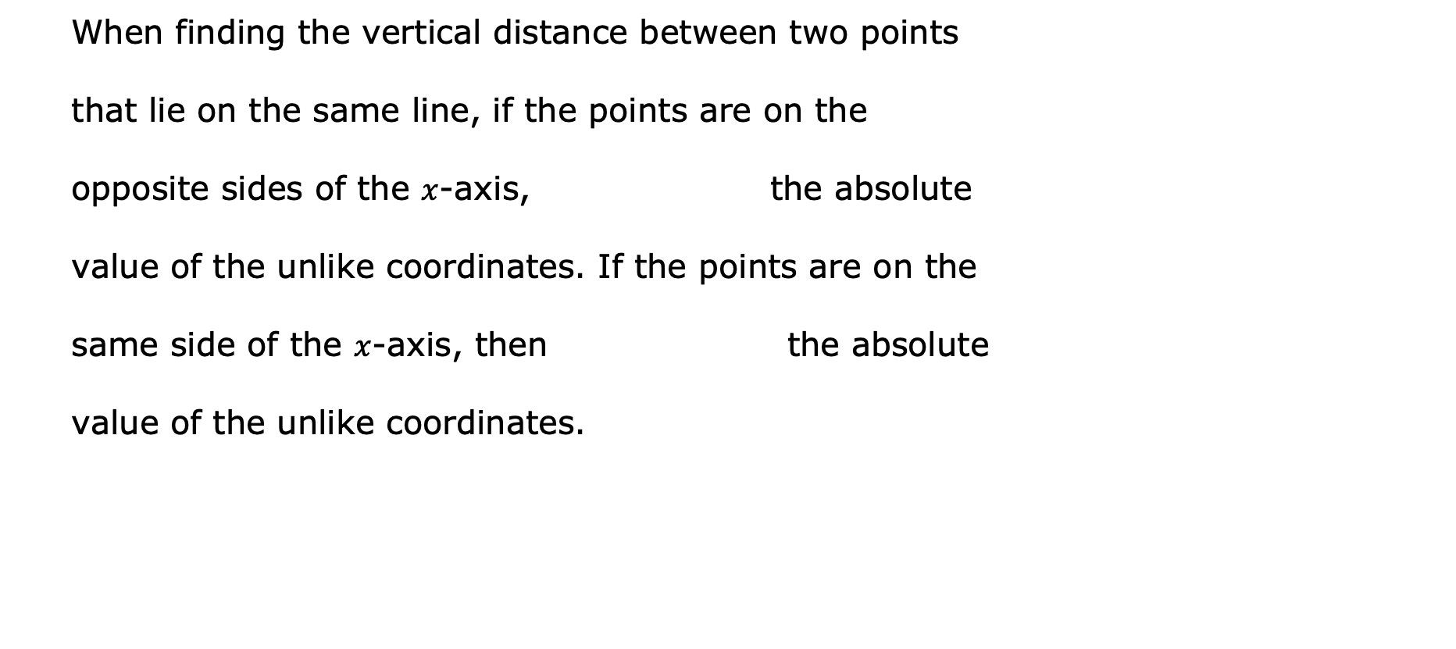
When finding the vertical distance between two points
that lie on the same line, if the points are on the
opposite sides of the $x$-axis, the absolute
value of the unlike coordinates. If the points are on the
same side of the $x$-axis, then the absolute
value of the unlike coordinates.
add
subtract
add
subtract
volume 1, pg. 230

Slide 20

Guided Practice
volume 1, pg. 231

Slide 21

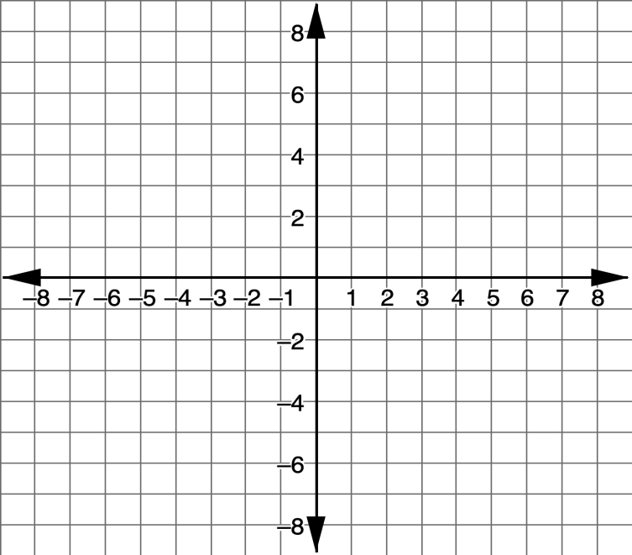
5.5.4 Guided Practice: Distances Between Rational Numbers
Graph the points $E$ ($−5\frac{1}{3}, 4\frac{1}{2}$) and $F$ ($7\frac{2}{3}, 4\frac{1}{2}$) on the coordinate plane.
volume 1, pg. 231

Slide 22
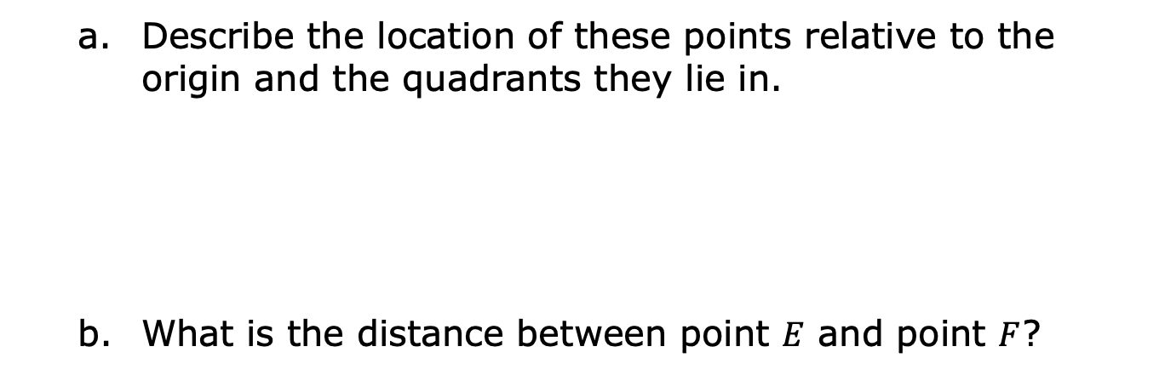
Describe the location of these points relative to the origin and the quadrants they lie in.
What is the distance between point $E$ and point $F$?
volume 1, pg. 231

Slide 23
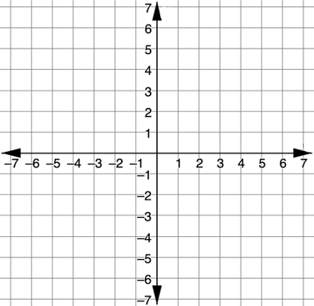

Graph the points $K$ ($−4, −3.25$) and $M(−4, −0.5$) on the coordinate plane.
Describe the location of these points relative to the origin and the quadrants they lie in.
volume 1, pg. 231

Slide 24
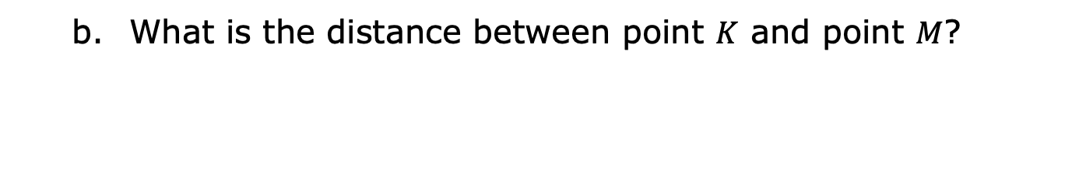
What is the distance between point $K$ and point $M$?
volume 1, pg. 231

Slide 25

Your Turn
volume 1, pg. 232

Slide 26
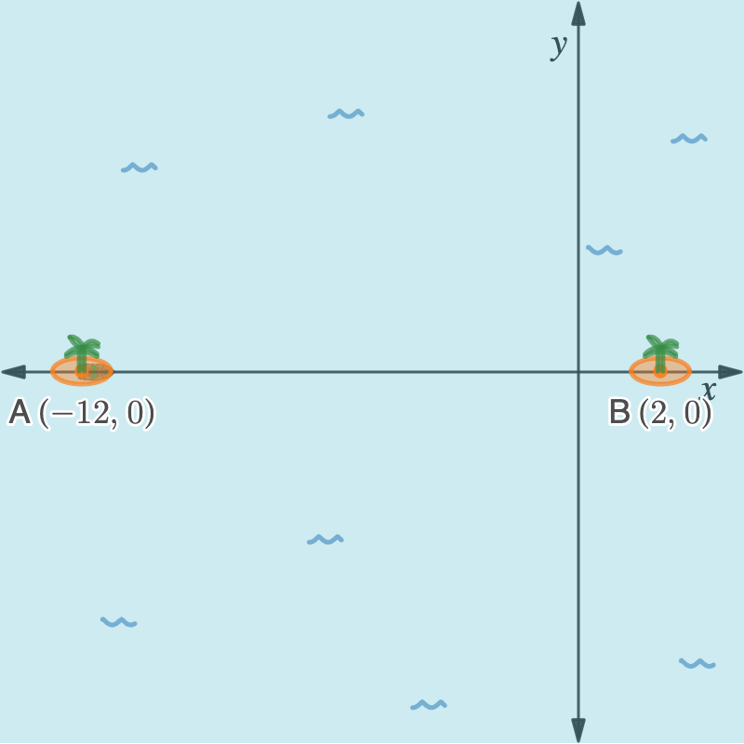
5.5.5 Your Turn!
What is the distance from point $A$ to point $B$?
volume 1, pg. 232

Slide 27

Explain which island is closest to island $A$. Show your work.
volume 1, pg. 232

Slide 28
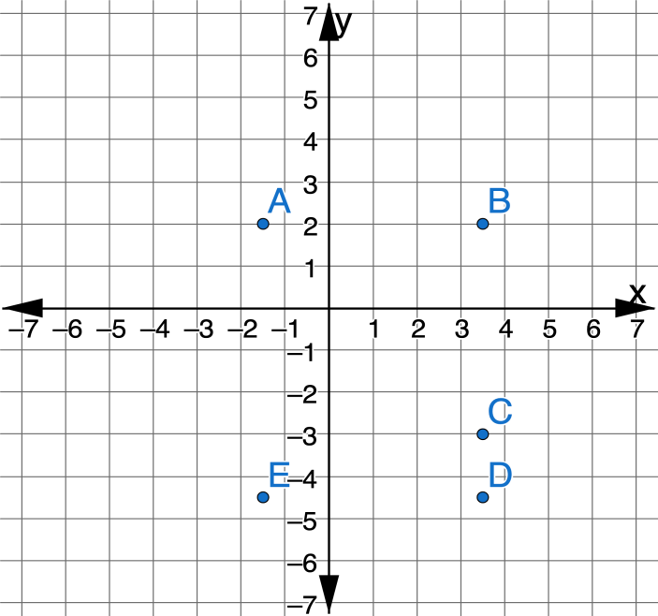
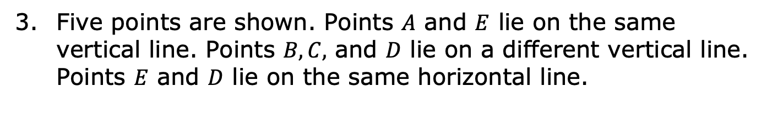
Five points are shown. Points $A$ and $E$ lie on the same vertical line. Points $B, C,$ and $D$ lie on a different vertical line. Points $E$ and $D$ lie on the same horizontal line.
volume 1, pg. 233

Slide 29
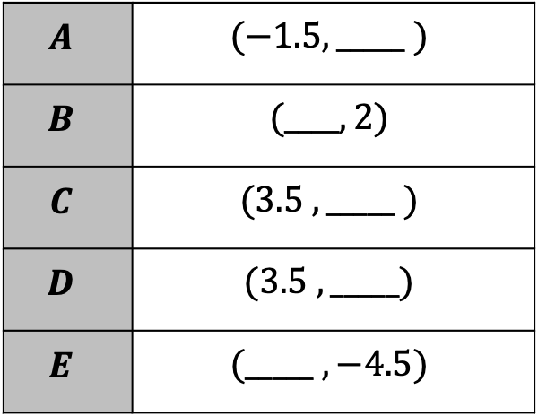

Complete the table by filling in each missing coordinate.
The distance between points B and C is _______ units.
The distance between points D and $C$ is _______ units.
The distance between points D and E is _______ units.
$$A$$ | $$(−1.5, _____ )$$
$$B$$ | $$(____, 2)$$
$$C$$ | $$(3.5 , _____ )$$
$$D$$ | $$(3.5 , _____)$$
$$E$$ | $$(_____ , −4.5)$$
volume 1, pg. 233

Slide 30
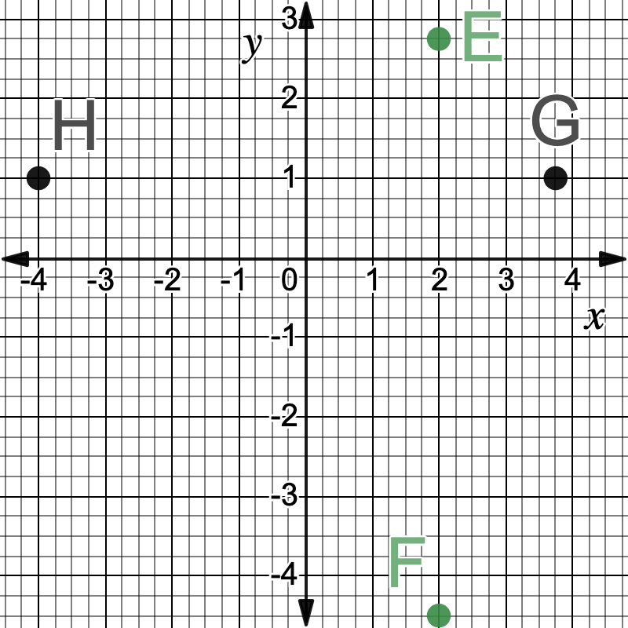

Use the coordinate plane below to determine distances between the following points.
The distance between points E and F is _____ units.
The distance between points G and H is _____ units.
Which points are the same distance from $(2, 1)$?
volume 1, pg. 233

Slide 31

Wrap-Up
volume 1, pg. 234

Slide 32
5.5.6 Wrap-Up: Cool Down
Your friend is absent today and will need the notes from class. Write a quick note to help them learn how to find the distance between two points on a coordinate plane.
volume 1, pg. 234

